Slide 1
Scientific Data Reduction: benefit and lessons learned
Qian Gong⁺, Jieyang Chen*, Norbert Podhorszki⁺, Ana Gainaru⁺, Sanjay Ranka#, Scott Klasky⁺
+: Oak Ridge of National Laboratory
*: University of Alabama, burmingham
#: University of Florida
Notes:
Present using MGARD compression for climate simulation

Slide 2
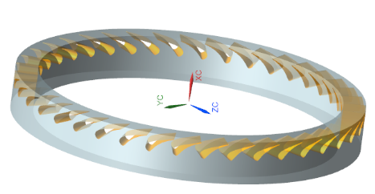
The data tsunami
The data’s volume, velocity, variety, and value are growing exponentially.
Scientific explorations are increasingly constrained by the I/O overhead and the amount of data can be stored and efficiently retrieved.
SKA1-LOW
SKA1-MID
XGC fusion
Wind turbine simulation at GE
1.4TB per
output step
336 TB in total
2 Pb/s
9 Tb/s
6K GPUs on 1K Frontier nodes
2.4x10⁴ steps or 20 hours
write out every 100 steps
1 TB/step
Multi-stage reduction/filtering
1024 Frontier nodes, 20 hours
600 PB/yr
SKA Regional Centers
2 PB in total

Slide 3
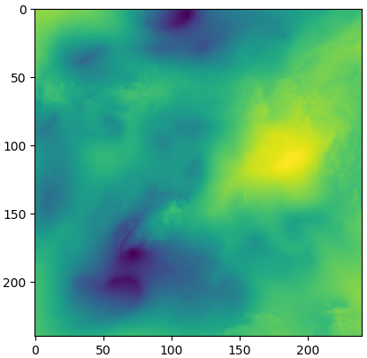
Lossy data compression
Data compression serving as promising solutions for
Reducing the time to write/read to storage
Reducing the storage footprint
Standard lossless compression takes time away from computation and I/O but typically only can reduce the data size by at most 20%
Error-bounded lossy compression often reduces data sets by >10X
E3SM (sea level pressure)
Original
Lossy compressed (CR = 28.5,
NRMSE = 5e-4)
Lossless with ZSTD: CR = 1.28

Slide 4
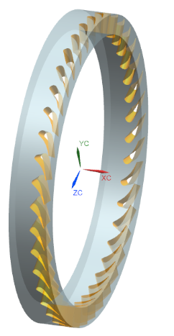
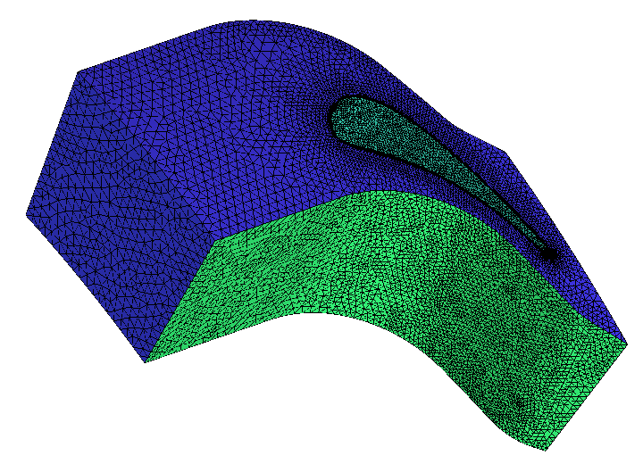
Use-case 1: GE Wind Turbine Simulations on OLCF Summit
GE is creating next generation simulations to optimize the efficiency of wind turbines and execute these on the OLCF Summit and Frontier resources on over 1K nodes for 20 hours
They generate 1.4 TB data per output step on 6K GPUs on Summit and want to write data at every 100 steps (300 wallclock seconds)
They used CGNS with HDF5 for “efficient” I/O, but because of the size it takes 2700s/step
Converting the data to ADIOS-2 BP5 reduced the time to 6s (2% overhead)
The initial thought to use lossy compression to reduce the I/O time was wrong
The total output data is now 336 TB, and they need to move it to GE HQ but it’s too much data to store at GE, so we use lossy compression to help reduce the total size for long term storage

Slide 5
Use-case 2: checkpoint restart (C/R) files
C/R files for many leading HPC simulations occur once per hour
Example: The largest XGC running on Summit on 6K nodes, writing 3 trillion particles
Output of the C/R is over 218 TB/step
I/O of XGC using ADIOS 2 on Summit is >1.8 TB/s (when running on all Summit)
The average overhead of writing C/R = 121s/3600s = 3.4%
The overhead is too low to compress, compression will NOT help!
But if we write “all of the physics” = every step (38s /step) then we need to compress (for analysis) but a 20 hours run will generate 403 PB
The most we can store on Summit is 2 PB for a month, so we create a PDF of the particles = 1.2TB/step = 2.2 PB (still too large for the analysis) → compression will help!

Slide 6
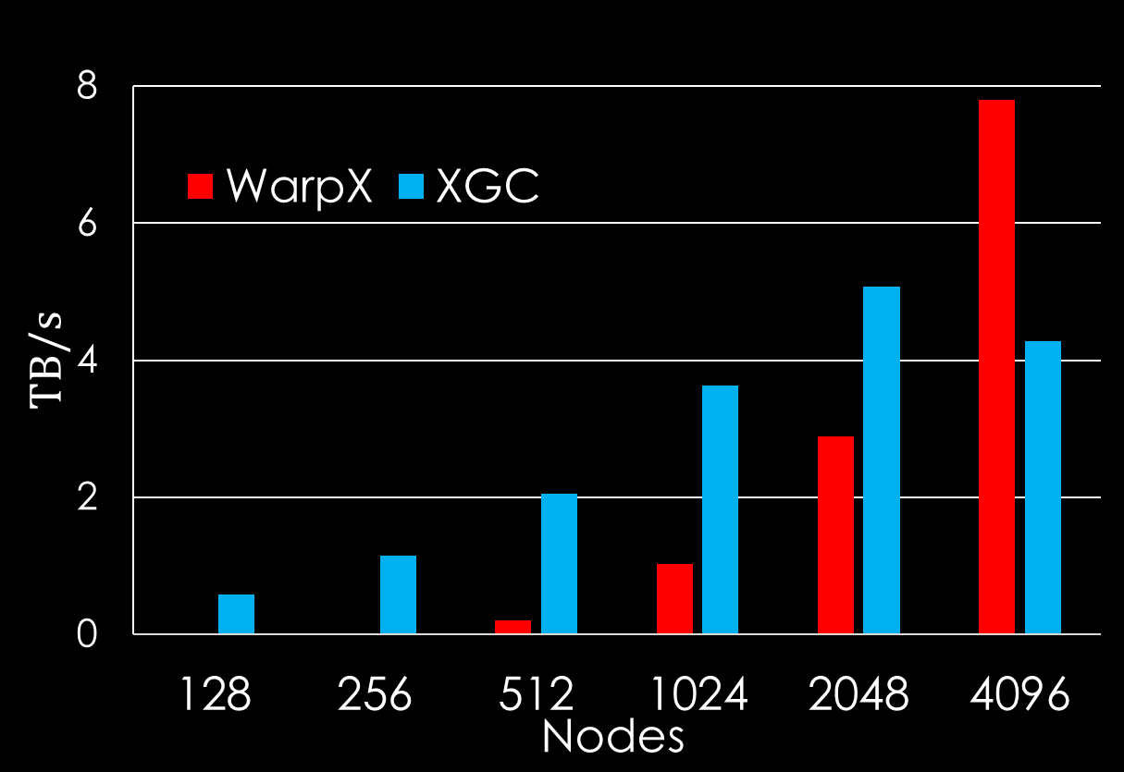
Use-case 3: I/O acceleration
Fully optimized parallel I/O can be extremely fast
How about the throughput of compressors?
ADIOS on Frontier
Application | Nodes/GPUs | Data Size/step | I/O speed
GTC | 512/3072 | 2.6 TB | ~2 TB/sec
XGC | 512/3072 | 64 TB | 1.2 TB/sec
LAMMPS | 512/3072 | 457 GB | 1 TB/sec
ADIOS on
Summit
GPU compression rates are higher than I/O bandwidth
Note: on a single CPU, MGARD’s compression rate is ~0.4GB/s and ZFP is ~2GB/s, which are slower than I/O bandwidth

Slide 7
GPU compression pipeline optimization
Highly efficient pipeline for compression on GPUs
Reducing >90% data movement overhead
Minimizing other memory operation overhead

Slide 8
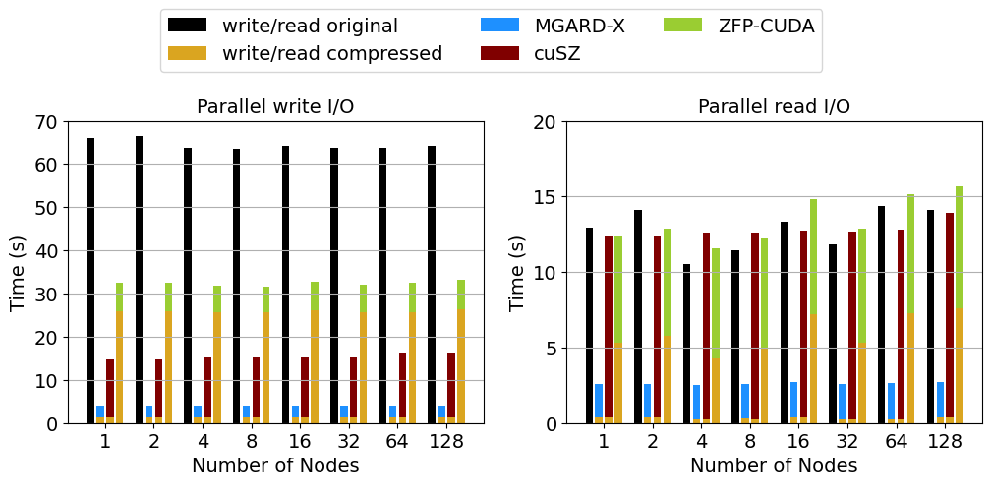
Fully optimized compressions accelerate I/O operations
End-to-end I/O time with compression/decompression
NYX data on Summit nodes (6 V100 GPUs/node)
15 GB per GPU, using a relative L² error bound of 1e-3
Final thoughts:
What if users request smaller errors → limited compression ratios w/ overhead from compression…
Can the compression keep up with the advancement of I/O?
MGARD-X: w/ pipeline optimization
ZFP-CUDA, cuSZ: without pipeline optimization

